Slide 1
DUAL ACCESS CONTROL FOR CLOUD BASED DATA STORAGE AND SHARING
Team Details:
1.G KEERTESHWAR REDDY (20EG105410)
2.MAHESH PAWAR (20EG105424)
3.D AKHIL (20EG105716)
Project Supervisor:
E. Radhakrishnaiah
Assistant Professor-CSE
Department of Computer Science and Engineering

Slide 2
Introduction
What is cloud computing?
Cloud computing is the use of computing resources (hardware and software) that are delivered as a service over a network (typically the Internet). The name comes from the common use of a cloud-shaped symbol as an abstraction for the complex infrastructure it contains in system diagrams. Cloud computing entrusts remote services with a user's data, software and computation. Cloud computing consists of hardware and software resources made available on the Internet as managed third-party services. These services typically provide access to advanced software applications and high-end networks of server computers.
How Cloud Computing Works?
The goal of cloud computing is to apply traditional supercomputing, or high-performance computing power, normally used by military and research facilities, to perform tens of trillions of computations per second, in consumer-oriented applications such as financial portfolios, to deliver personalised information, to provide data storage or to power large, immersive computer games.The cloud computing uses networks of large groups of servers typically running low-cost consumer PC technology with specialised connections to spread data-processing chores across them. This shared IT infrastructure contains large pools of systems that are linked together. Often, virtualisation techniques are used to maximise the power of cloud computing.
Department of Computer Science and Engineering

Slide 3
Introduction
Cloud-based data storage service has drawn increasing interests from both academic and industry in the recent years due to its efficient and low cost management. Since it provides services in an open network, it is urgent for service providers to make use of secure data storage and sharing mechanism to ensure data confidentiality and service user privacy.
In this project, we consider the dual access control, in the context of cloud-based storage, in the sense that we design a control mechanism over both data access and download request without loss of security and efficiency. Two dual access control systems are designed in this project, where each of them is for a distinct designed setting.
Mainly we serve with Role based mechanisms to provide different varieties of access to each one. Along with this it is enhanced with cryptography and different enclaves for each person using this project. Once deployed you can use our system easily with any cloud storage mechanisms.
The main applications of our system can be used in College-Person Data Management, Patient-Doctor Data Management, Financial Transaction Management.
Department of Computer Science and Engineering

Slide 4
Problem Statement
In the context of cloud-based data storage and sharing, the current challenge resides in establishing a robust and comprehensive access control system that ensures both security and flexibility.Existing single-layer access control mechanisms often fall short in adequately addressing the intricate demands of data security, leading to vulnerabilities and potential breaches.
To protect sensitive data from being compromised, the most widely used method is encryption. However, simply encrypting data (e.g., via AES) cannot fully address the practical need of data management. Besides, an effective access control over download request also needs to be considered so that Economic Denial of Sustainability (EDoS) attacks cannot be launched to hinder users from enjoying service.Implementation of a dual access control framework that effectively integrates multiple layers of authentication and authorisation protocols.
Department of Computer Science and Engineering

Slide 5
Problem Statement
Implementing a dual access control framework in cloud-based data storage and sharing is a crucial step towards bolstering security and flexibility. One fundamental aspect of this framework involves the integration of multi-factor authentication (MFA) mechanisms. MFA enhances security by requiring users to provide two or more types of authentication factors before they are granted access. These factors typically include something they know (e.g., a password or PIN), something they have (e.g., a mobile device or smart card), and something they are (e.g., biometric data like fingerprints or facial recognition).
By demanding multiple forms of authentication, MFA significantly reduces the risk of unauthorised access, as even if one factor is compromised, an attacker would still need to bypass the additional layers of security. This makes it extremely challenging for malicious actors to gain access to sensitive data, even if they manage to obtain one piece of the authentication puzzle. So we used enhanced
CP-ABE algorithm
Department of Computer Science and Engineering

Slide 6
Proposed Method
The proposed method outlined dual access control in cloud-based data storage and sharing through the use of encryption and access control mechanisms. This approach focuses on ensuring data confidentiality and service user privacy in an open network environment. Key components and mechanisms involved:
Attribute-Based Encryption (ABE): To protect sensitive data from unauthorised access, ABE, particularly Cipher-text-Policy ABE (CP-ABE), is employed. CP-ABE allows data owners to define access policies over encrypted data, enabling fine-grained control over who can decrypt the data based on their attributes.
Dual Access Control Mechanism: The system implements a dual access control mechanism that operates on both data access and download requests. This ensures that only authorised users can access and download the stored data, protecting against unauthorised access and potential Economic Denial of Sustainability (EDoS) attacks.
Use of Intel SGX: To further secure the data and control access, the system utilises Intel Software Guard Extensions (SGX) for creating secure and isolated execution environments (enclaves). This aids in protecting the execution of sensitive code and data from unauthorised access, even if the system is compromised.
Department of Computer Science and Engineering

Slide 7
Proposed Method
Proposed Method: Secure, Efficient, and Controlled Access to Cloud-Based Data:
Step-1: Design a Secure Authentication System
Step-2: Implement Role-Based and Attribute-Based Access Control
Step-3: Utilise Encryption for Data at Rest and in Transit
Step-4: Audit and Monitoring System
Step-5: User Training and Awareness
Step-6: Regular Security Assessments and Updates
Step-7: Data Backup
Department of Computer Science and Engineering

Slide 8
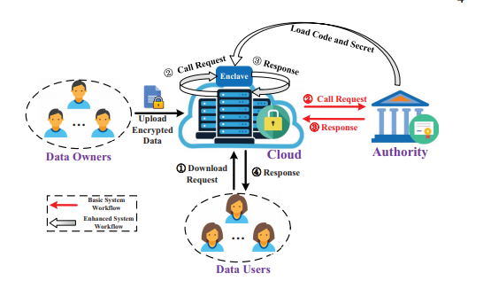
Proposed Method
The simple representation illustrates the flow of users authenticating, accessing data, storing data, and sharing data within the cloud-based system. Access control mechanisms are applied to control who can access or share data.
Department of Computer Science and Engineering

Slide 9
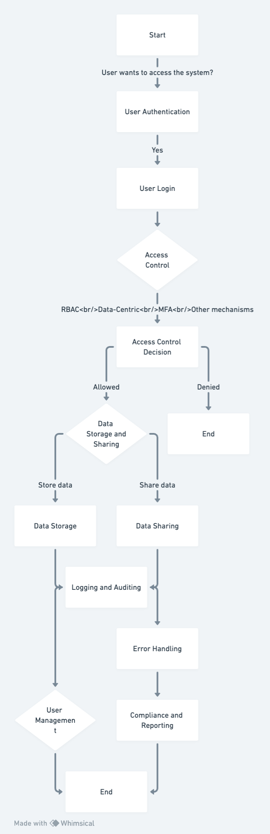
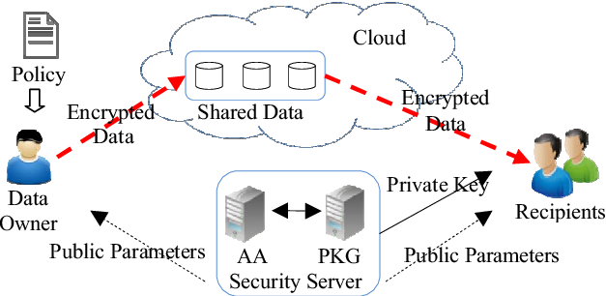
Proposed Method
Department of Computer Science and Engineering

Slide 10
Experiment Environment
Hardware Requirements:
System : Intel Core i5 Processor
RAM : 8GB
Hard Disk : 1 TB HDD
Input Devices : Keyboard, Mouse
Software Requirements:
Operating system : Windows 10.
Coding Language : JAVA.
Tool : Netbeans 8.2
Database : MYSQL
Cloud : Drive HQ
Department of Computer Science and Engineering

Slide 11
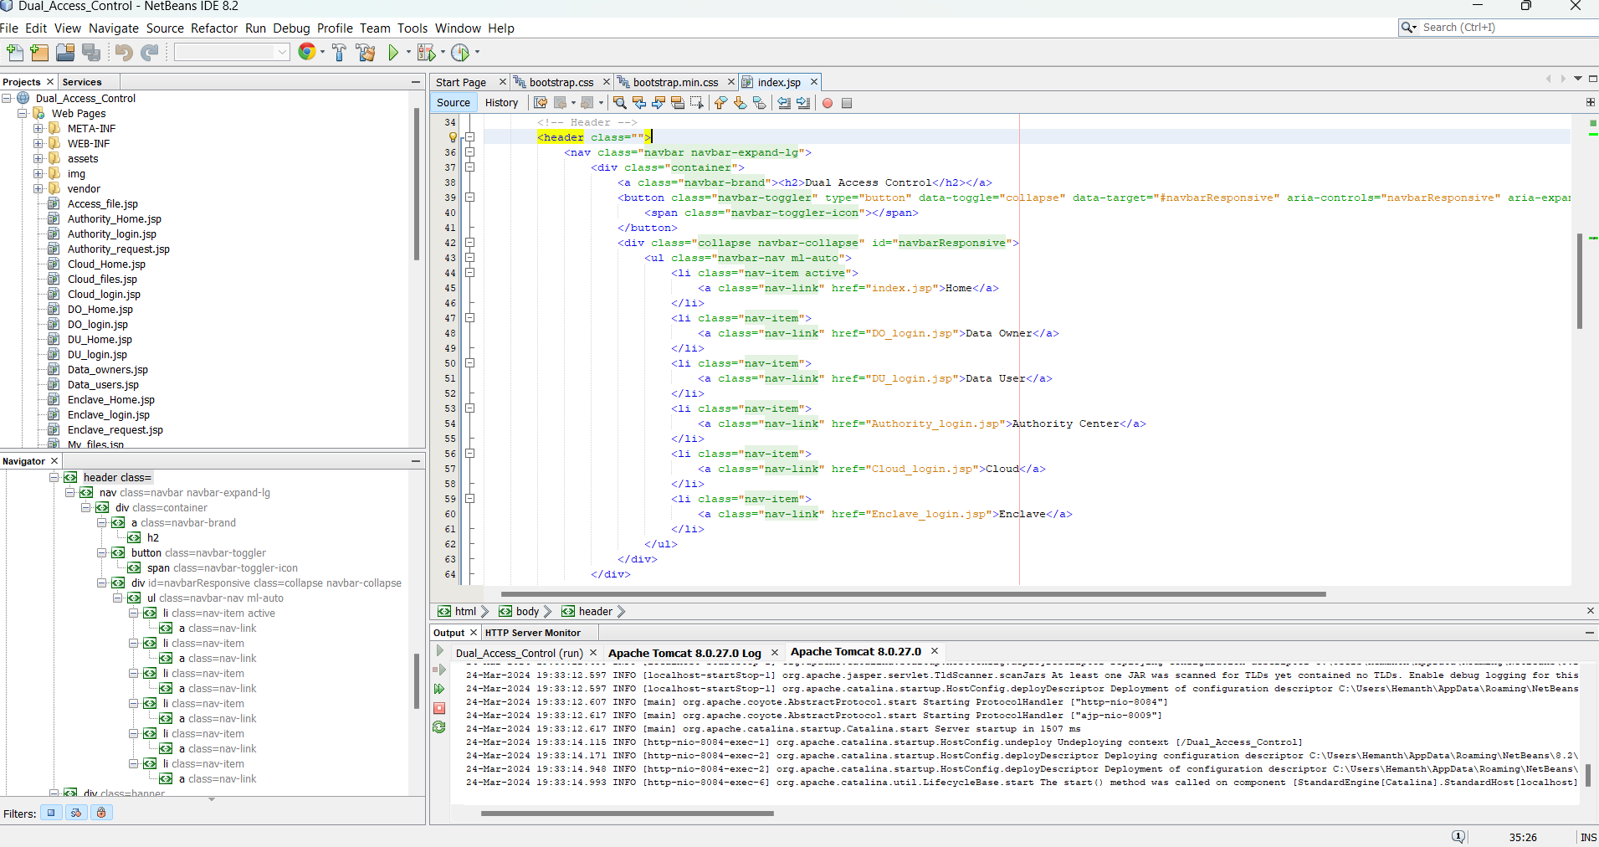
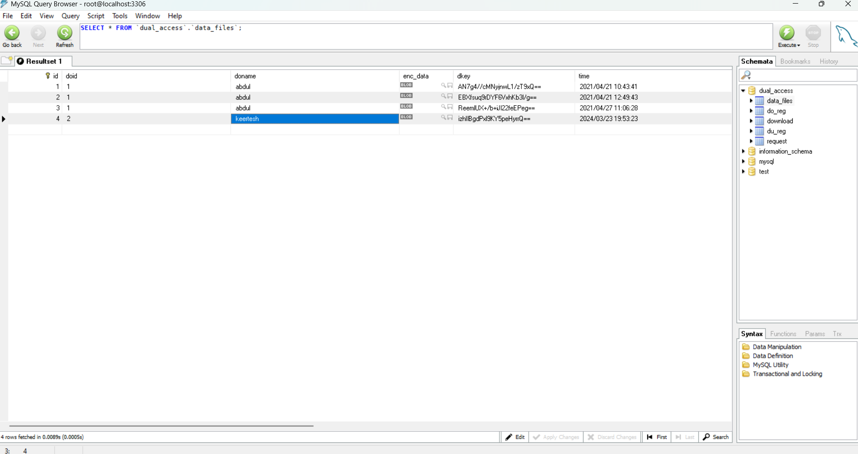
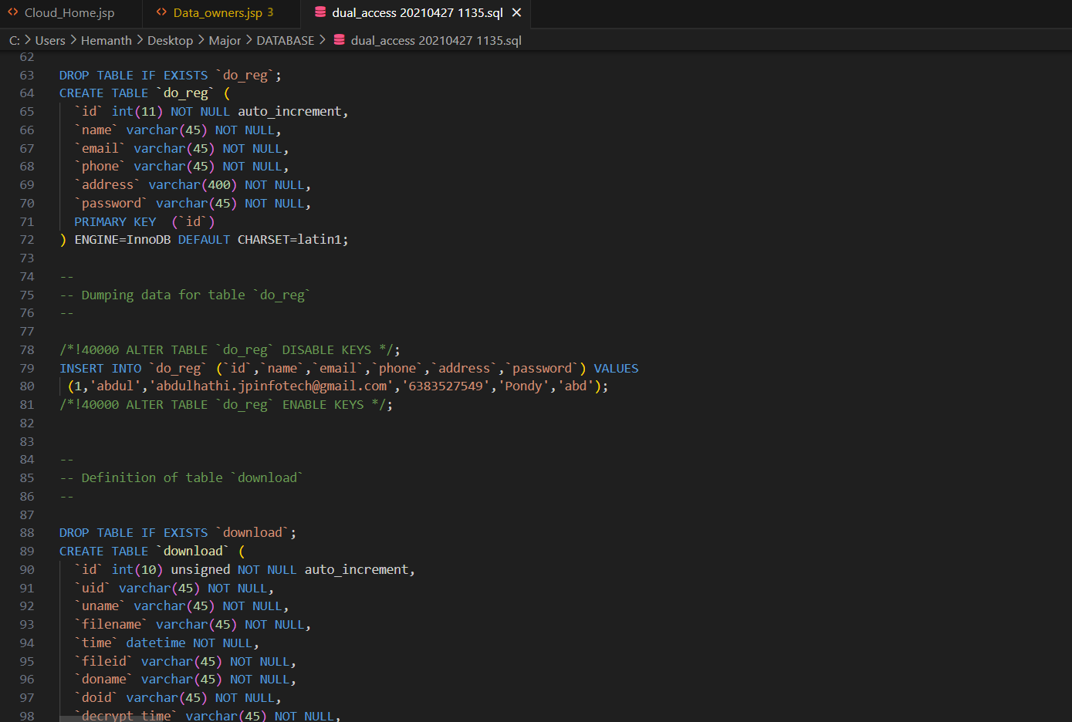
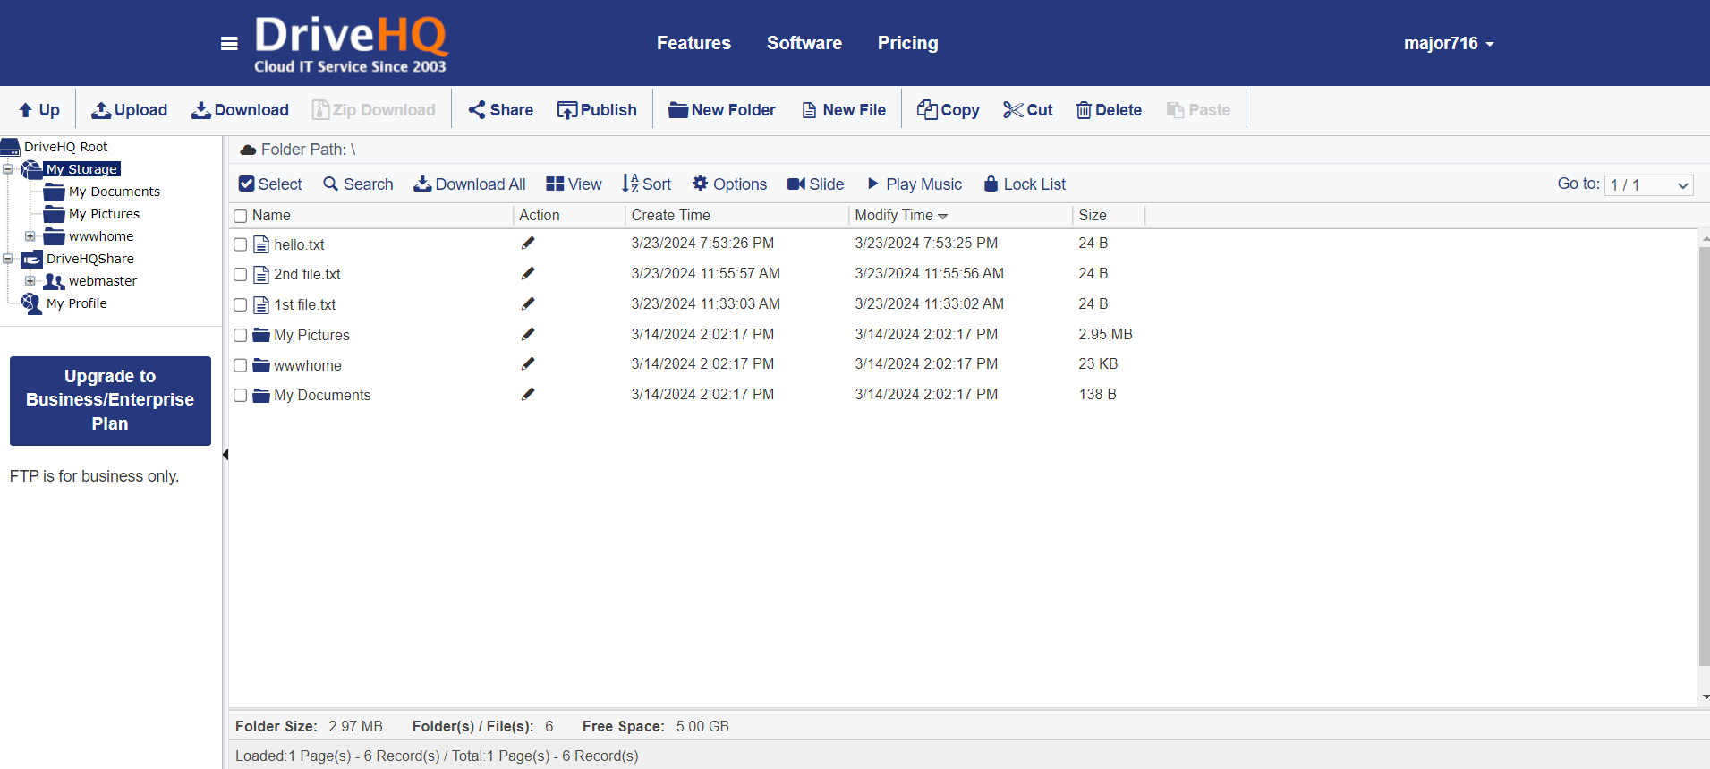
Experiment Environment
Department of Computer Science and Engineering

Slide 12
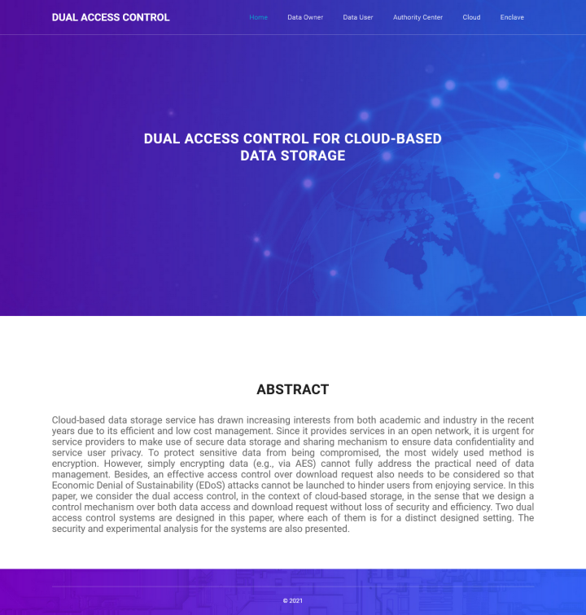
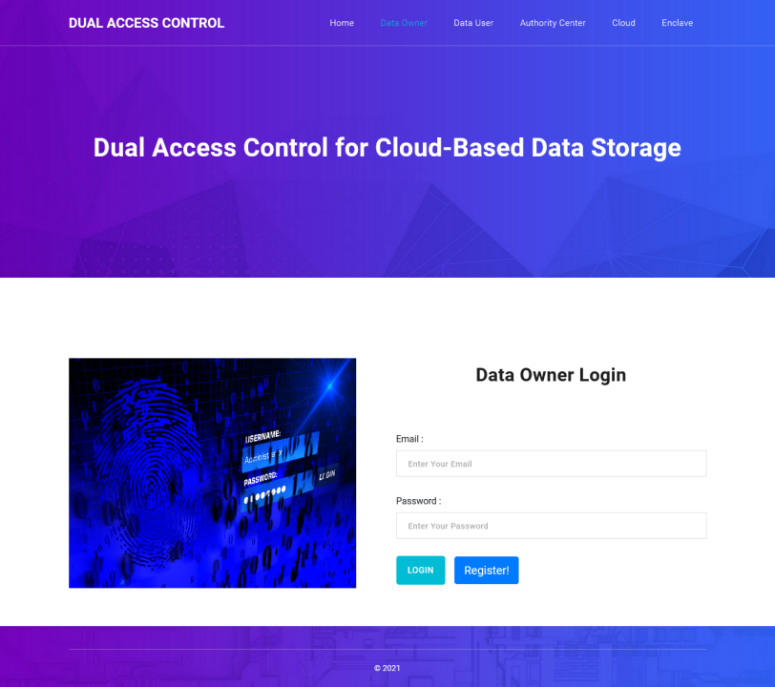
Experiment Screen shorts
Department of Computer Science and Engineering

Slide 13
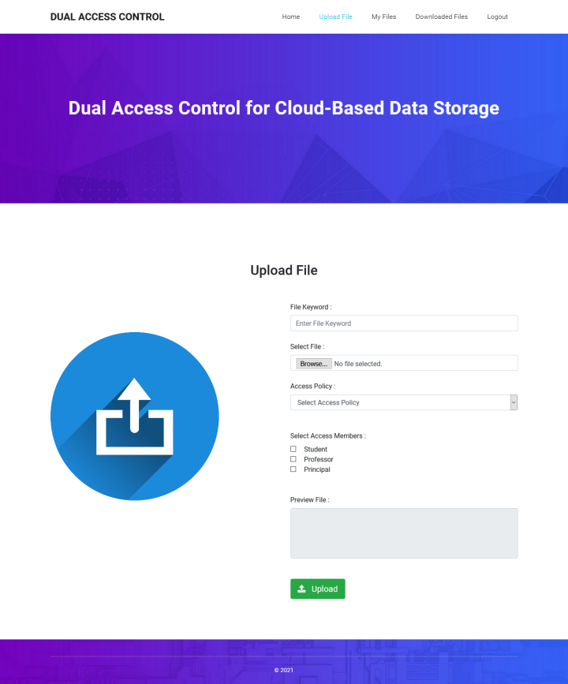
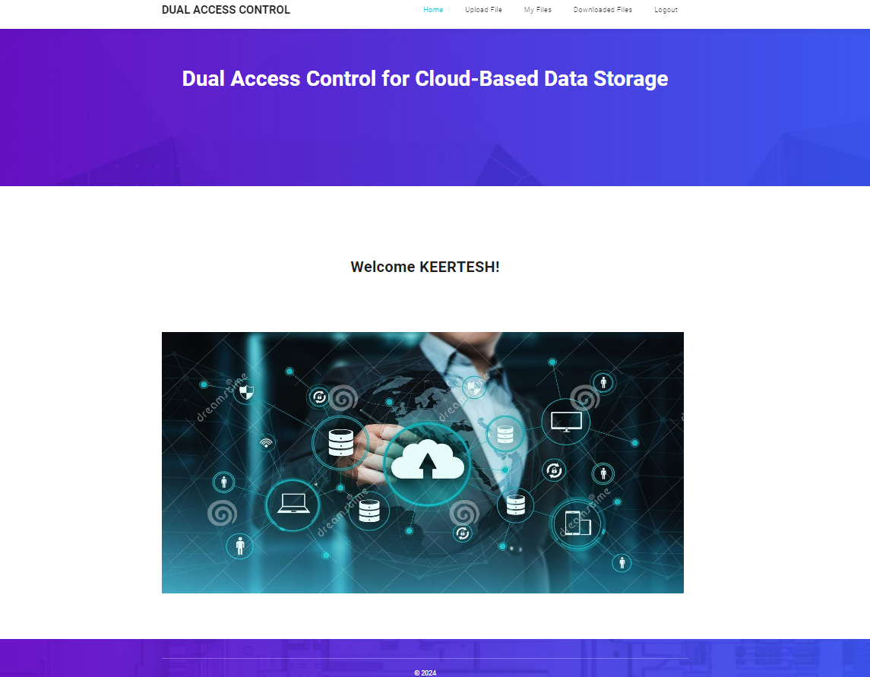
Experiment Screen shorts
Department of Computer Science and Engineering

Slide 14
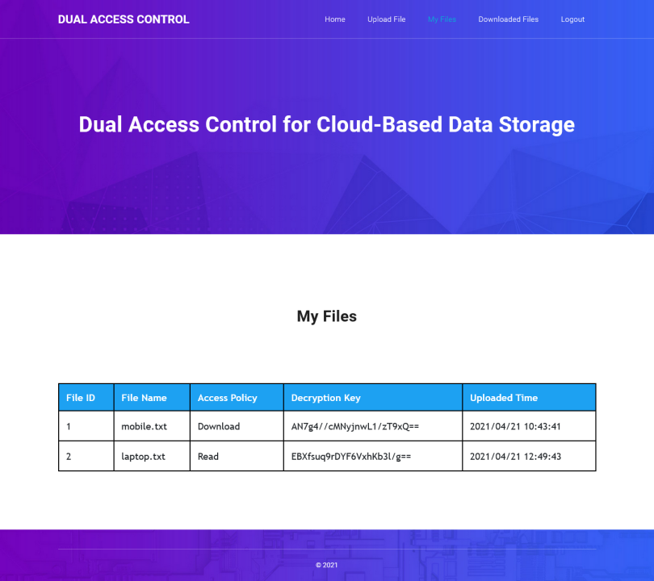
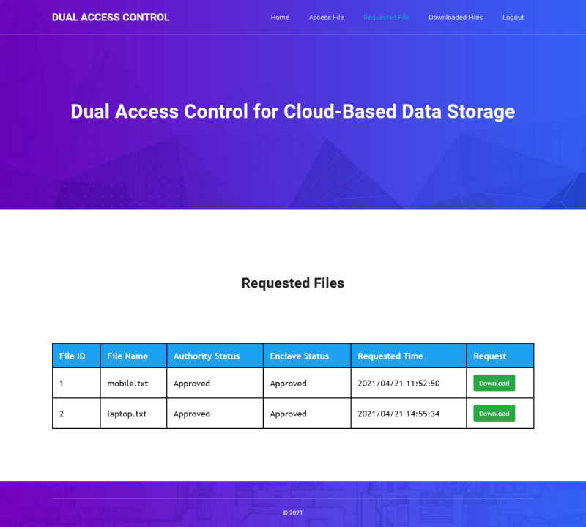
Experiment Screen shorts
Department of Computer Science and Engineering

Slide 15
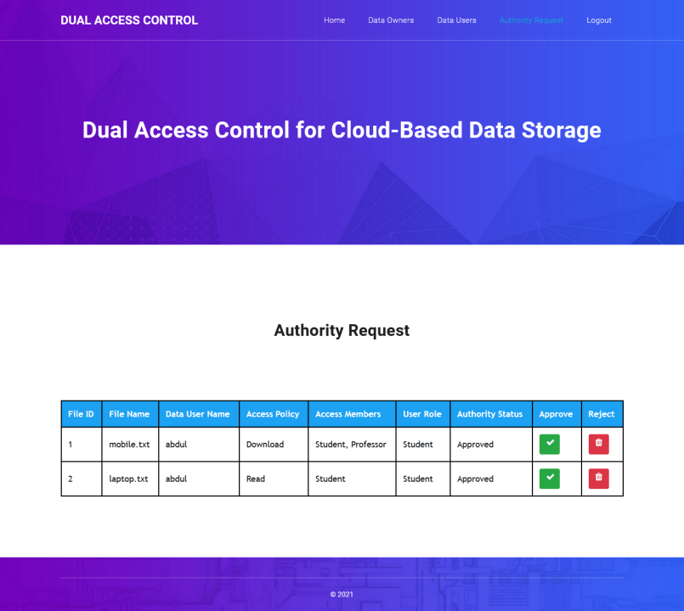
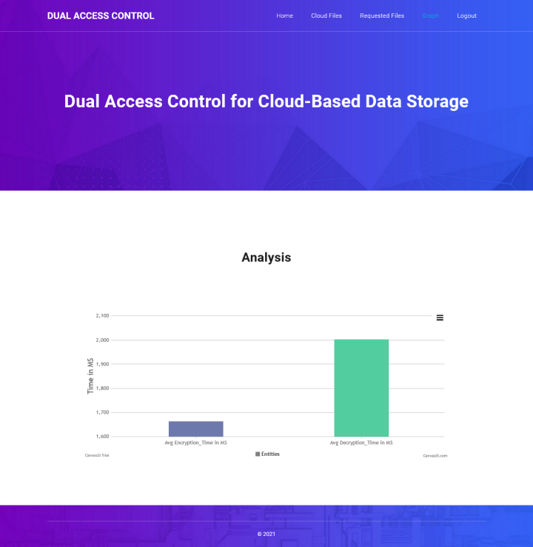
Experiment Screen shorts
Department of Computer Science and Engineering

Slide 16
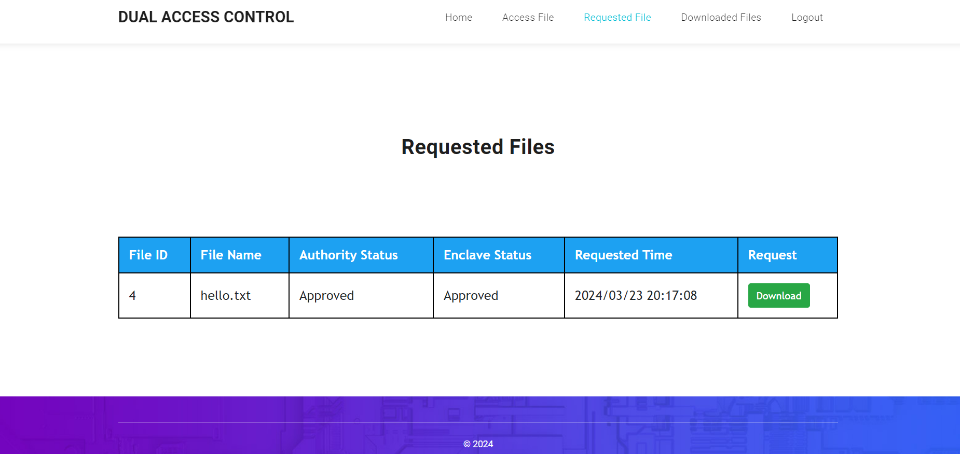
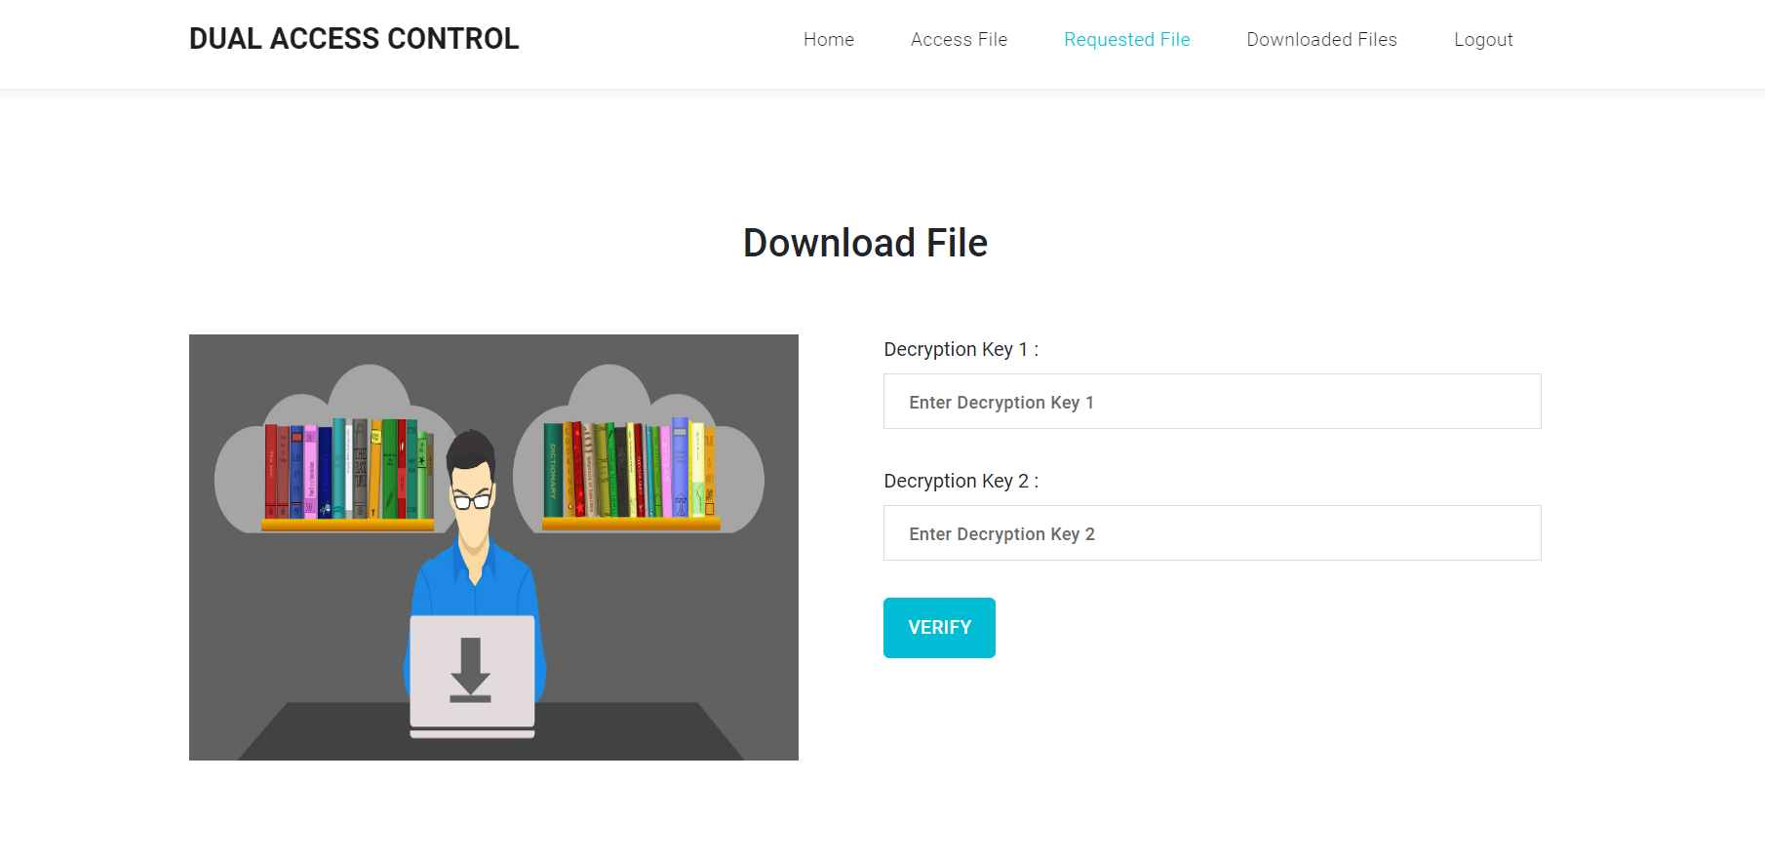
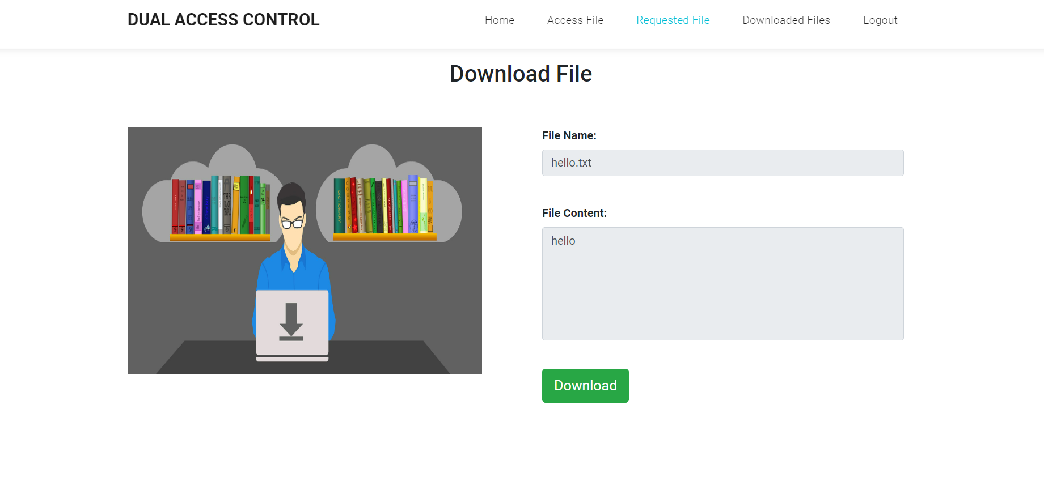
Experiment Results
Department of Computer Science and Engineering

Slide 17
Experiment Results
Department of Computer Science and Engineering

Slide 18
Finding
We addressed an interesting and long-lasting problem in cloud-based data sharing, and presented two dual access control systems. The proposed systems are resistant to DDoS/EDoS attacks. We state that the technique used to achieve the feature of control on download request is “transplantable” to other CP-ABE constructions.
Our experimental results show that the proposed systems do not impose any significant computational and communication overhead (compared to its underlying CP-ABE building block).
In our enhanced system, we employ the fact that the secret information loaded into the enclave cannot be extracted.
However, recent work shows that enclave may leak some amounts of its secret(s) to a malicious host through the memory access patterns or other related side-channel attacks.
The model of transparent enclave execution is hence introduced. Constructing a dual access control system for cloud data sharing from transparent enclave is an interesting problem. In our future work, we will consider the corresponding solution to the problem.
Department of Computer Science and Engineering

Slide 19
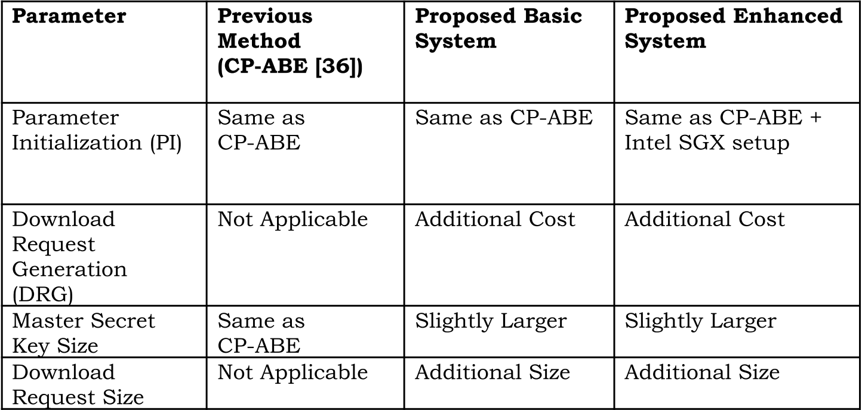
Justification
Department of Computer Science and Engineering

Slide 20
Justification
1) Access Control Effectiveness (ACE): ACE measures how well the dual access control system prevents unauthorised access to sensitive data. It can be calculated as: ACE = (Number of Authorized Accesses) / (Total Access Attempts) * 100% This formula provides a percentage that reflects the success rate of the access control mechanism.
2) Data Availability (DA): Data availability is crucial to ensure users can access their data when needed. It can be calculated as: DA = (Total Uptime) / (Total Uptime + Total Downtime) * 100% This formula calculates the percentage of time when the data storage and sharing system is available.
3) Latency and Response Time (LRT): Latency and response time are important for user experience. You can calculate the average latency as: LRT = (Σ Latency measurements) / (Total number of measurements) This formula calculates the average time it takes for the system to respond to user requests.
Department of Computer Science and Engineering

Slide 21
Justification
Confidentiality of Outsourced Data:
Existing System: The reliance on SGX for key revocation and hybrid encryption introduces potential security vulnerabilities. If the SGX enclave is compromised, the confidentiality of encrypted data is at risk.
Proposed System: By employing a dual access control mechanism with CP-ABE as a foundational layer, the proposed system enhances data confidentiality. It ensures that data is encrypted and only accessible by users who match the specified access policy, without solely relying on SGX for security.
Anonymity of Data Sharing:
Existing System: The existing system does not explicitly address the anonymity of data owners or users, which could potentially expose sensitive information about data transactions.
Proposed System: The proposed system guarantees the anonymity of the data owner and users during data storage and sharing. This is achieved by encrypting data under specific access policies and handling download requests in an anonymous manner, thereby protecting the identities of parties involved.
Fine-grained Access Control:
Existing System: The existing approach, while utilising ABE for access control, still relies heavily on SGX for revocation, which does not inherently provide fine-grained access control.
Proposed System: Introducing CP-ABE into the proposed system allows for more nuanced and fine-grained access control policies. This enables data owners to define precise criteria for who can access their data, enhancing security and flexibility.

Slide 22
Justification
Resistance to EDoS Attacks:
Existing System: The computational and bandwidth demands of the existing system, especially in generating and handling challenge cipher texts, could inadvertently facilitate EDoS (Economic Denial of Sustainability) attacks by overloading the cloud with expensive operations.
Proposed System: The new mechanism controls download requests more efficiently, mitigating the risk of EDoS attacks. By avoiding the generation of challenge cipher texts and instead validating download requests directly, it reduces the computational load and bandwidth usage, making the system less susceptible to exploitation.
High Efficiency:
Existing System: The need for generating challenge cipher texts and the requirement for data users to decrypt them impose significant computational and bandwidth burdens on both data owners and users.
Proposed System: By eliminating the need for challenge cipher texts and allowing for direct authorisation checks on download requests, the proposed system significantly reduces the computational and bandwidth requirements. This not only speeds up the data access process but also makes the system more scalable and user-friendly.
Department of Computer Science and Engineering

Slide 23
THANK YOU.

